Slide 1

CULTURE’S INFLUENCE ON LEADERSHIP EFFICIENCY
Authors: Gabriel J. Byrne & Frank Bradley
PRESENTED BY:
Muqaddas Nazeer 2021-CS-183
Kanzul Zoha 2021-CS-186
Khadim Hussain 2021-CS-204
Yasir Baig 2021-CS-215
PRESENTED TO:
Ms. Samina Yaqub

Slide 2


AGENDA
INTRODUCTION
RESEARCH METHODOLOGY
RESEARCH BACKGROUND
STATISTICAL ANALYSIS
KEY RESEARCH FOCUS
HYPOTHESIS
PROBLEM STATEMENT
FINDINGS
CONCEPTUAL FRAMEWORK
CONCLUSION

Slide 3


INTRODUCTION & RESEARCH BACKGROUND
LEADERSHIP & GLOBALIZATION
Leadership success is shaped by personal & national culture
Traditional models (e.g., Porter’s framework) are losing relevance
Adaptability is now the key to effective leadership
KEY QUESTION
What makes a leader effective across different cultural settings?
LEADERSHIP IN A GLOBAL MARKET
Adaptive Leadership
Values-Based Leadership

Slide 4
KEY RESEARCH FOCUS & PROBLEM STATEMENT
PROBLEM STATEMENT
How do personal values and national culture influence leadership effectiveness?
Do different leadership styles play in driving a firm's international success?
KEY RESEARCH QUESTIONS
Which has a greater influence on leadership effectiveness: personal values or national culture?
Schwartz’s Value Framework
RESEARCH FRAMEWORK:
Personal Values – The beliefs and principles that guide an individual’s behavior.
Cultural Values – The collective expectations and traditions of a society.

Slide 5
CONCEPTUAL FRAMEWORK
1.1 PERSONAL & CULTURAL VALUES IN LEADERSHIP
Leadership style is shaped by personal values (beliefs & priorities)
National culture sets leadership expectations in organizations
Effective leadership balances personal values with cultural norms
1.2 THE GESTALT EFFECT OF PERSONAL VALUES
Leaders hold a bundle of personal values that shape their style
These values create a holistic leadership approach rather than isolated traits
The strongest influence on leadership comes from founders’ core values

Slide 6
CONCEPTUAL FRAMEWORK CONT..
1.3 RESEARCH HYPOTHESES
Successful leadership is not one-size-fits-all. Different leadership styles succeed in different cultures.
Leadership style directly impacts a company’s performance in global markets.
H1
H2
Personal values shape leadership at an individual level, but national culture shapes leadership expectations.
National culture plays a more dominant role than personal values.
H3
H4

Slide 7
RESEARCH METHODOLOGY OVERVIEW
FIRMS SAMPLED
COUNTRIES STUDIED
159 firms across the three countries
Data collected using surveys & structured questionnaires
Denmark (34)
Finland (58)
Ireland (68)
DATA RELIABILITY & CONFIDENCE LEVEL
OBJECTIVE
95% confidence level ensures reliability
Validated data collection for accuracy
How leadership values affect firm performance
The relationship between personal values, cultural background, & leadership style

Slide 8
MEASUREMENT OF LEADERSHIP & CULTURAL VARIABLES
VARIABLES MEASURED:
Hard Metrics: Sales growth, profit over last 5 years.
Soft Metrics: Leaders’ personal/cultural values (using Schwartz’s 57 personal and 45 cultural values).
MEASUREMENT APPROACH
Leadership traits categorized based on behavioral alignment
Firm success linked to leadership effectiveness through performance indicators
Schwartz’s model used to classify personal & cultural leadership influences

Slide 9
STATISTICAL ANALYSIS
OBJECTIVE
METHODOLOGY
To identify personal values that correlate with overall and international performance.
Cross-product Deviation Analysis
Pearson Bivariate Analysis
Factor Analysis
COUNTRIES STUDIED
FIRMS SAMPLED
Denmark
Finland
Ireland.
159 firms across the three countries

Slide 10
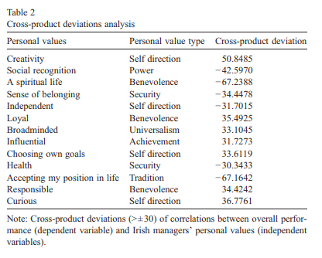
CROSS-PRODUCT DEVIATIONS FOR IRISH MANAGERS' PERSONAL VALUES
Cross-product Deviation:
This measure shows how strongly personal values relate to firm performance. Higher values (positive or negative) mean a stronger link.
Positive Values:
Positive values mean that the personal value supports better firm performance. For example, Creativity (50.8485) significantly enhances performance.

Slide 11
CROSS-PRODUCT DEVIATIONS FOR IRISH MANAGERS' PERSONAL VALUES
Negative Values:
Negative values indicate that the personal value is associated with lower firm performance. For example, social recognition(-42.5970) tends to reduce overall performance.
Table 2 Summary:
Table 2 quantifies how various personal values impact firm performance for Irish managers, emphasizing key values like creativity and spiritual life that drive success.

Slide 12
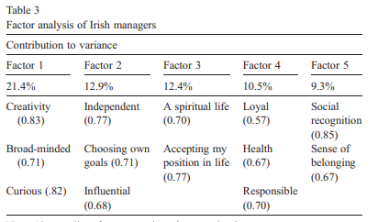
FACTOR ANALYSIS
Purpose
This table presents the results of factor analysis on the personal values of Irish managers
Table 3 Summary
Table 3 identifies key personal values (e.g., creativity, independence) shaping leadership style in Irish managers through factor analysis.

Slide 13
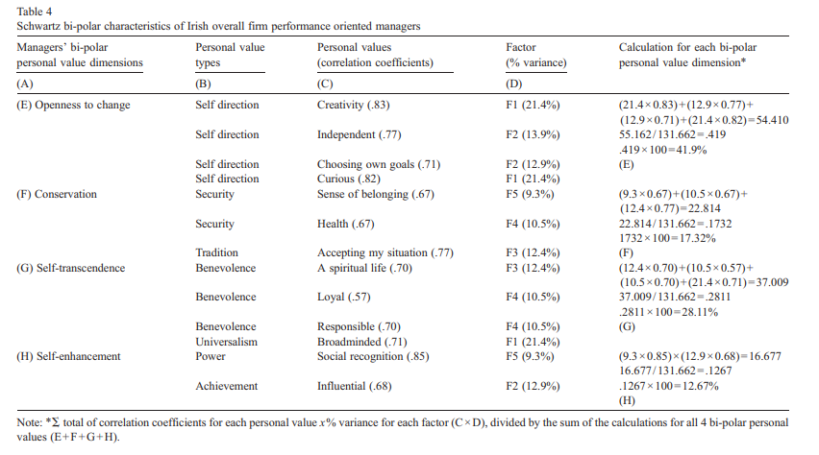
SCHWARTZ BI-POLAR CHARACTERISTICS OF IRISH OVERALL FIRM PERFORMANCE-ORIENTED MANAGERS

Slide 14
Purpose: This table shows the bi-polar personal value dimensions for Irish managers oriented towards overall firm performance.
Key Insights:
Openness to Change (41.9%) is the most significant dimension, indicating that Irish managers oriented towards overall performance value openness to change highly.
Conservation (17.32%) is the next significant dimension, indicating a moderate value placed on conservation.
Self-transcendence (28.11%) and Self-enhancement (12.67%) are also important dimensions, indicating a balance between self-transcendence and self-enhancement values.

Slide 15
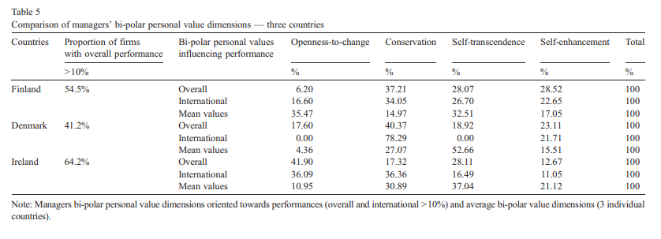
BI-POLAR PERSONAL VALUES INFLUENCING PERFORMANCE IN THE THREE COUNTRIES
Table 5 compares how bi-polar personal value dimensions (e.g., Openness-to-Change, Conservation) influence overall and international firm performance in Finland, Denmark, and Ireland.

Slide 16
RESULTS
Irish managers show the highest openness to change, which correlates with higher overall performance.
Finnish managers have a moderate level of openness to change but a higher level of conservation.
Danish managers have the lowest openness to change and the highest conservation, indicating a preference for stability and tradition.
These findings highlight the importance of cultural context in shaping leadership styles and firm performance.

Slide 17
HYPOTHESIS TESTTING
HYPOTHESIS 1
Hypothesis H1: Successful leadership style is pluralistic.
Findings:
Leadership styles vary widely across countries.
Irish managers show high "openness-to-change" style.
Finnish managers show high "conservation" style.
Danish managers show high "conservation" style.
Conclusion:
Leadership styles are indeed pluralistic, confirming H1.

Slide 18
HYPOTHESIS TESTTING
HYPOTHESIS 2
Hypothesis H2: Successful leadership Style affect Firm Performance differently across countries:
Leadership Style Differences:
Impact On International Performance
Ireland has high performance of success (64%)
Finland 54% than Denmark 41%
Opennes to change
Ireland 40%
Finland 17%
Deanmark 0%
Conlusion: Internaltional perfornmance of suuccesful firms foucs on “Opennes to change”.

Slide 19
HYPOTHESIS TESTTING
HYPOTHESIS 3
Hypothesis H3: Personal & Cultural values differ in leadership styles:
Personal values:
Individual behavious that guide a leader
Example: Honesty, Creativity, Inner Peace.
Impact on leadership: Creativity and Innovation.

Slide 20
HYPOTHESIS TESTTING
HYPOTHESIS 3
2. Cultual values:
Shared beliefs and thoughts within an organization.
Example: Teamwork, Respect, Tradition.
Impact:
Strong teamwork
Collaboration and collective thinking instead of indiviual.
Conclusion: Personal and Cultural don’t influence leadership style in same way.

Slide 21
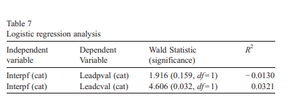
FINDINGS
CULTURAL VALUES
Cultural Values have stronger influence than personal values.
According to Wald Statistics Table:
Cultural values contribute 70% to mediation affect than personal values.
ratio(cultural : 4.606)
(personal: 1.916)
Conclusion:Culrural values shape leadership style more than personal values.

Slide 22
FINDINGS
2. LEADERSHIP STYLES
Leadership plays an important role in global business.
Key Findings:
National Culture dominate leadership style
Leadership style in cross-cultural business
History influence leadership style
Leadership style differences by country

Slide 23
CONCLUSION
Personal and cultural values are different.
Different culture have different leadership expectations.
Cultural values have stronger influence on leadership than personal values especially in international business.
Companies should deploy managers whose leadership aligns with the cultural expectations of the country, they operate in better for success.

Slide 24
THANK
YOU

